Slide 1
COURSERA CAPSTONE PROJECT
Seattle Road Accident Severity

Slide 2
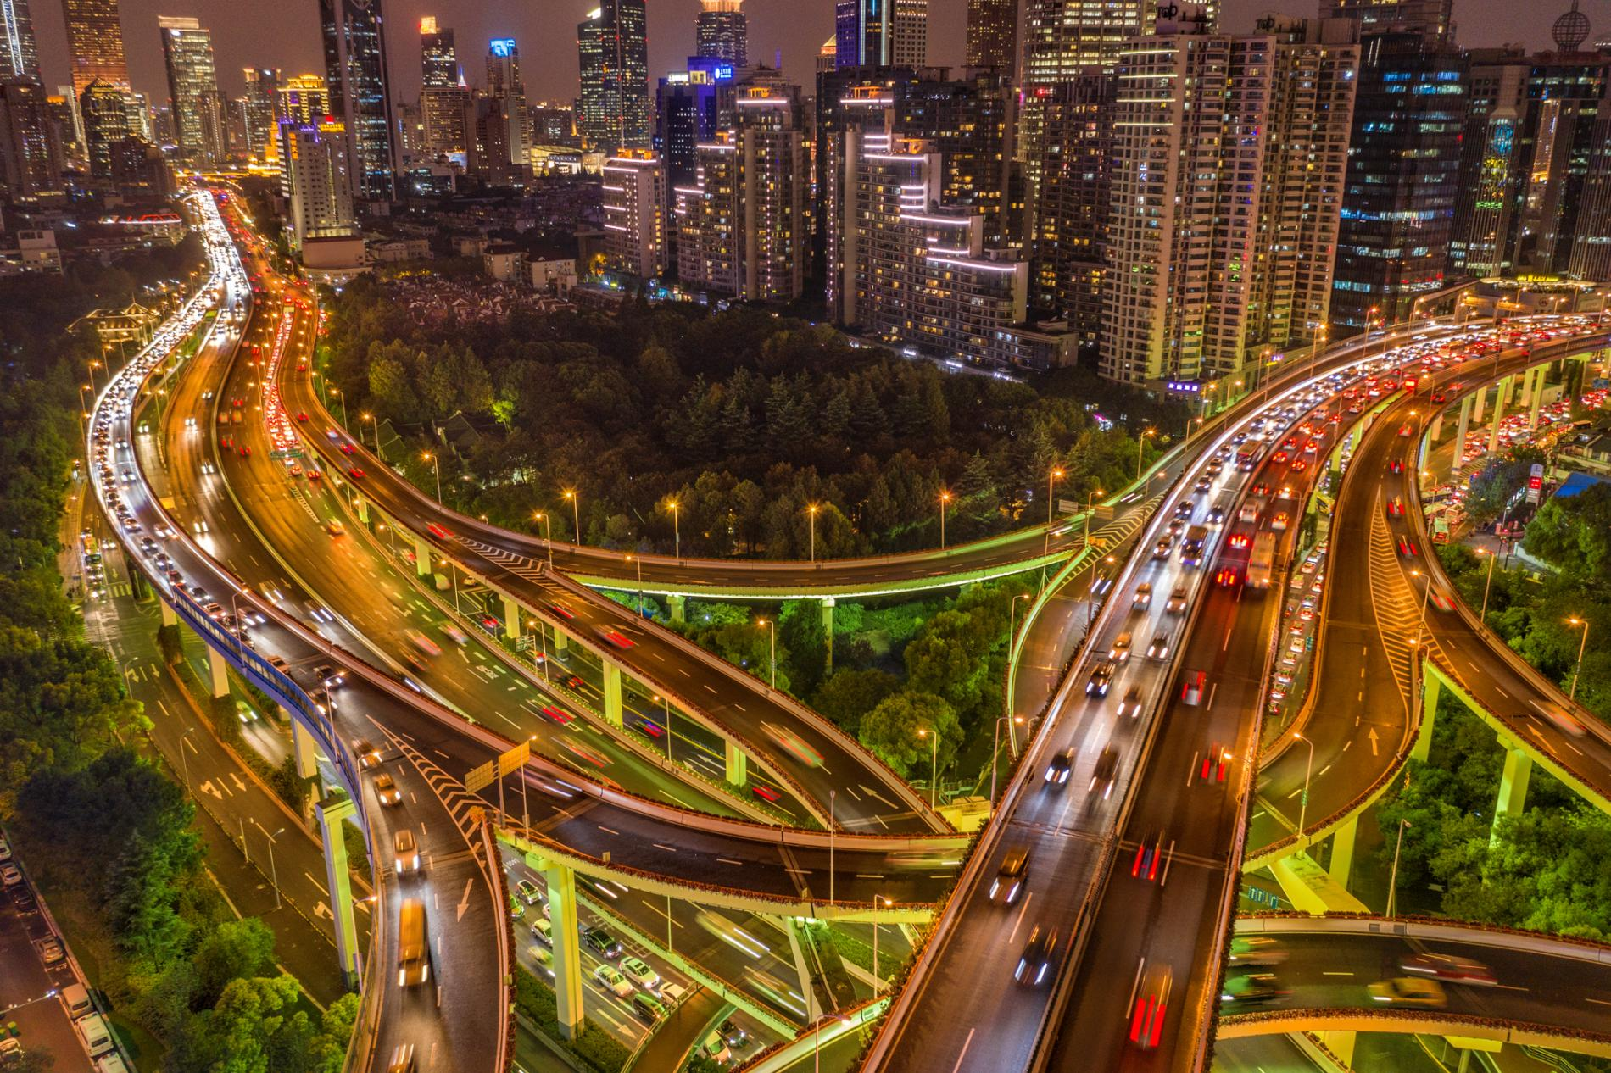
Introduction
Let's imagine, that my family and I have made plans of going out in the evening and everyone is almost ready. But suddenly I see flash of lightening outside, hear the roaring thunder and the pitter-patter of rain drops. Everyone gets disappointed as the elders start advising that it is not safe to drive in such conditions. We cancel the plan. However, we cannot do the same if it is an urgent meeting you have to attend or catch a flight for an important business opportunity overseas. Because the elders are just making vague predictions based on their experience. It is correct to a certain extent but these appointments cannot be missed based on predictions made with no certain proof.

Slide 3

Purpose of the Project
Thus, this project focuses on building a Machine Learning Model to predict the safety of the travelers (i.e.) the probability of an accident to occur based on various factors including weather, road conditions, traffic, etc. It helps make more accurate predictions based on the data collected from different accident locations in Seattle.
The information gathered by performing Data Analysis on the collected data will help the police forces and emergency medical evacuation team to warned and be prepared for being able to reach the location that are accident-prone areas. If found that the state of the roads are being a major cause for accidents, then the public works department can be notified about the amendments to be made for safe travel.

Slide 4
About the Dataset
The details of various accidents and the severity of the accident occurring at multiple locations across Seattle are collected and recorded to analyze and find the cause of accident so as to warn the concerned to take appropriate measures to reduce the accident rates.
The data for analysis was retrieved from the Road Accident Severity Data from the Seattle State Department of Transport from Data-Collisions
This dataset has an attribute SEVERITYCODE that classifies the accident into 5 different categories. code that corresponds to the severity of the collision:
3- Fatality
2b- Serious Injury
2- Injury
1- Property Damage
0- Unknown

Slide 5
Data Extraction
There are 38 columns of attributes in the dataset, out of which many attributes need not be considered for the analysis.
So we retain the important attributes for the accident to occur such as ROADCOND, LIGHTCOND and we can drop the remaining unnecessary parameters in the dataset.
Dropping NaN values from primary attributes before moving to the next step (we use the dropna function).

Slide 6
Data Cleaning
Starting with the extra attributes and homogenizing the data i.e. converting Yes/Y to 1, No/N to 0 and NaN values to 0 as most of the rows are 0 (average of entire column)

Slide 7
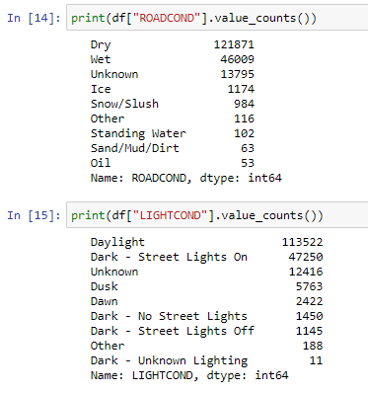
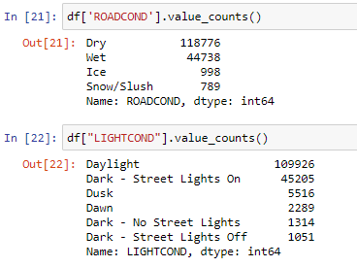
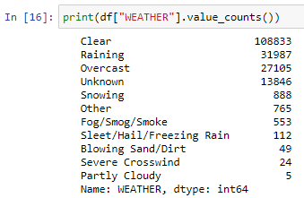
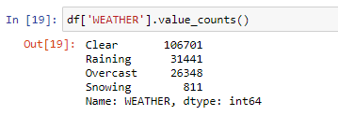
We shall drop the entries that contain insignificant and ‘Unknown’ values (this cleaning is carried out on ROADCOND, WEATHER and LIGHTCOND).
Before
After

Slide 8
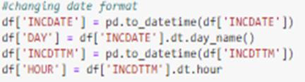
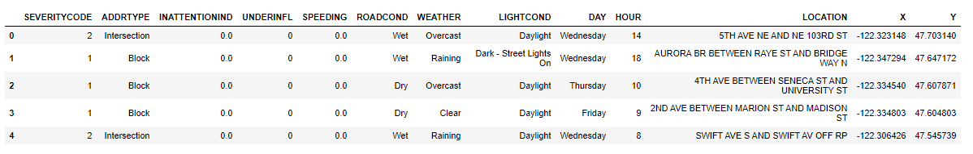
Creating new columns named day and hour from INCDATE and INCDTMM respectively using dt.day_name() and dt.hour functions.
After all the cleaning of data, a new dataframe with the following attributes is created.

Slide 9
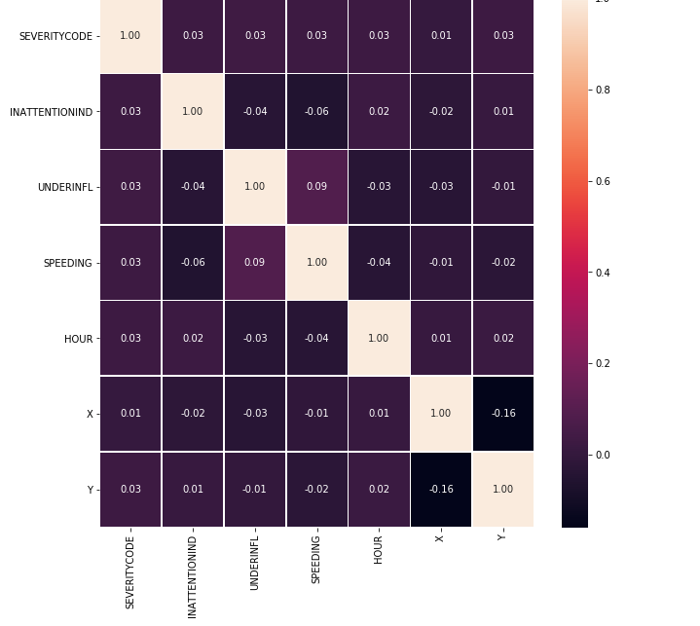
Visualizations
We can create a heat map to find the correlation among the features.

Slide 10
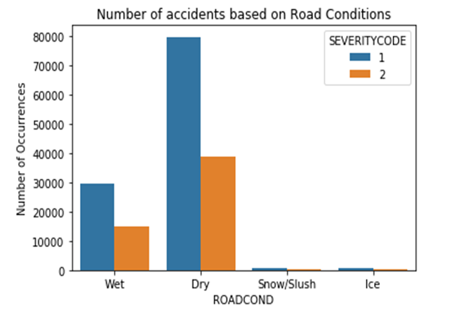
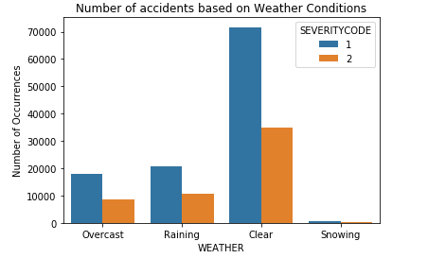
Exploratory Data Analysis
Based on plot for different road conditions, dry conditions causes the most number of accidents and the occurrence of injuries is greater than property damage.
Based on the plot for different weather conditions, clear conditions causes the most number of accidents and the occurrence of injuries is greater than property damage.

Slide 11
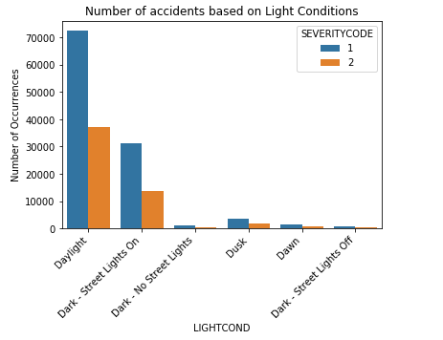
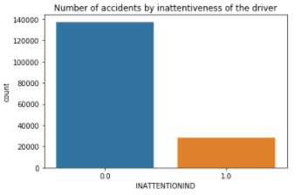
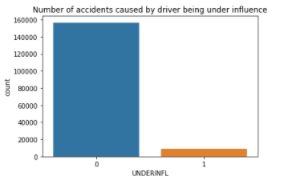
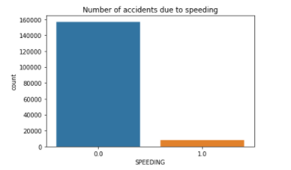
Based on plot for different light conditions, daylight causes the most number of accidents and the occurrence of injuries is greater than property damage.
Using countplot() I have visualized the number of accidents caused - by inattentiveness of the driver, by driver being under influence or by speeding.

Slide 12
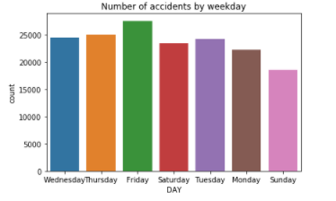
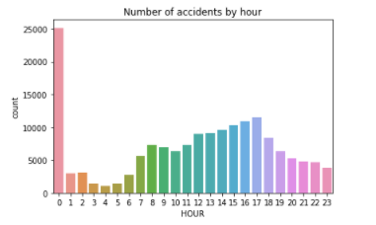
These are visualizations for accidents occurring on a particular weekday and at a particular hour of the day. It can be seen that 0000 hours have the most number of accidents. Similarly Friday witnessed the maximum number of incidents. Although the distribution for weekday is not as dramatic as that for accident by hour.

Slide 13
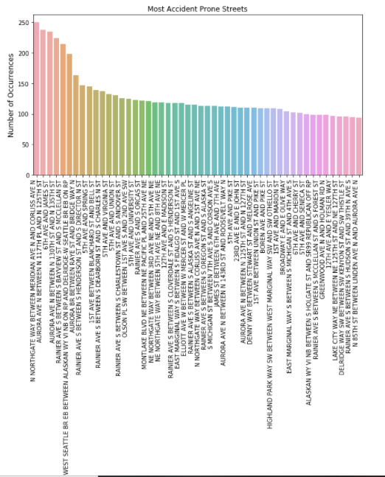
The barplot() function is used to plot the top 50 most accident prone streets/blocks in Seattle.
Most accident-prone street is Northgate Way between Meridian Avenue and Corliss Avenue.
The most accident prone street has witnessed 252 accidents.

Slide 14
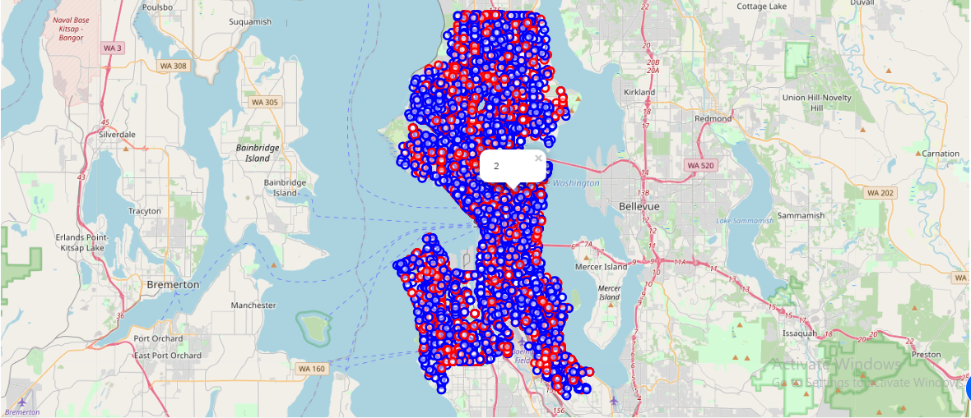
Using Folium and Features, a map visualization is created to plot all the accidents in various colors and a pop up marker to indicate the severity of each incident.
This plot shows the distribution of accidents and further modifications can be made to the parameters.
For example, all the incidents in the past year can be plotted and a grouping can be done for accidents occurring in a particular region.

Slide 15
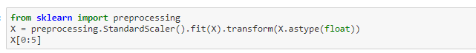
Predictive Analysis
Moving ahead with the modelling, I have used K-Nearest Neighbor, Decision Tree and Logistic Regression as the three machine learning algorithms. For each method, the evaluation metrics used are Jaccard score and F1 score along with log loss for Logistic Regression.
All the required libraries and packages are imported and after normalizing the data using StandardScalar(), the dataset is split into test and training set with 70% of the dataset being used to train the model.

Slide 16
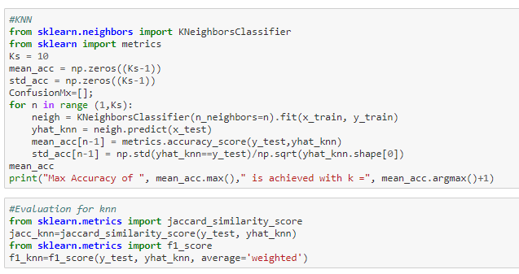
K-Nearest Neighbor
Starting with the KNN first, using a loop and calculating accuracy for each k value from 1 to 10, I obtained maximum accuracy for the test set for a k value of 4.

Slide 17
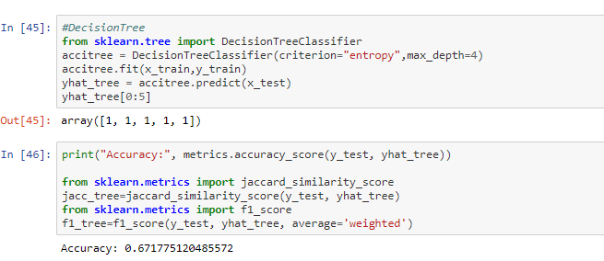
Decision Tree
Next model is decision tree, the classifier is defined with a max depth 4, and achieved an accuracy of 67.18%.
There is scope for refinement but I decided to go ahead with 4 as the max depth and fit the classifier using the training set and predicting target attribute using the test set.
F1 score and Jaccard score for this model is also evaluated.

Slide 18
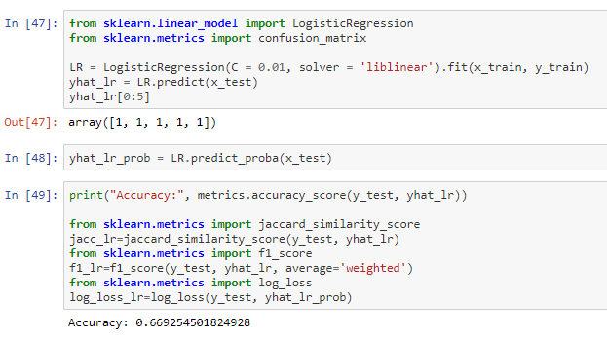
Logistic Regression
Lastly using Logistic Regression to create a predictor model, I have implemented the liblinear solver for a C value of 0.01. The probability for the predicted values is also calculated along with the metric evaluation.

Slide 19
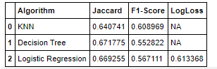
Results and Evaluation
Decision tree would be the best machine learning algorithm for this particular model as indicated by the highest Jaccard score of 0.6718.
A score of 0.6718 shows a decent balance between recall and precision.
It also indicates that road, weather and light conditions together with location and time of day with minor considerations of inattentiveness of driver and speeding can be used to predict severity of accident with an accuracy of 0.6718.
Although, Logistic Regression can also be used as it would work well with binary classification which is the case with our dataset (as it contains just two categories, 2-injury and 1-property damage).

Slide 20
Conclusion
Based on the dataset provided and the prediction model created using decision tree, we can conclude that particular weather, road and light conditions have some level of impact and responsible driving plays a major role in deciding whether the travel could result in property damage or an injury.
If implemented properly can result in saving many lives and huge sums of money on a yearly basis for the city of Seattle.

